Slide 1
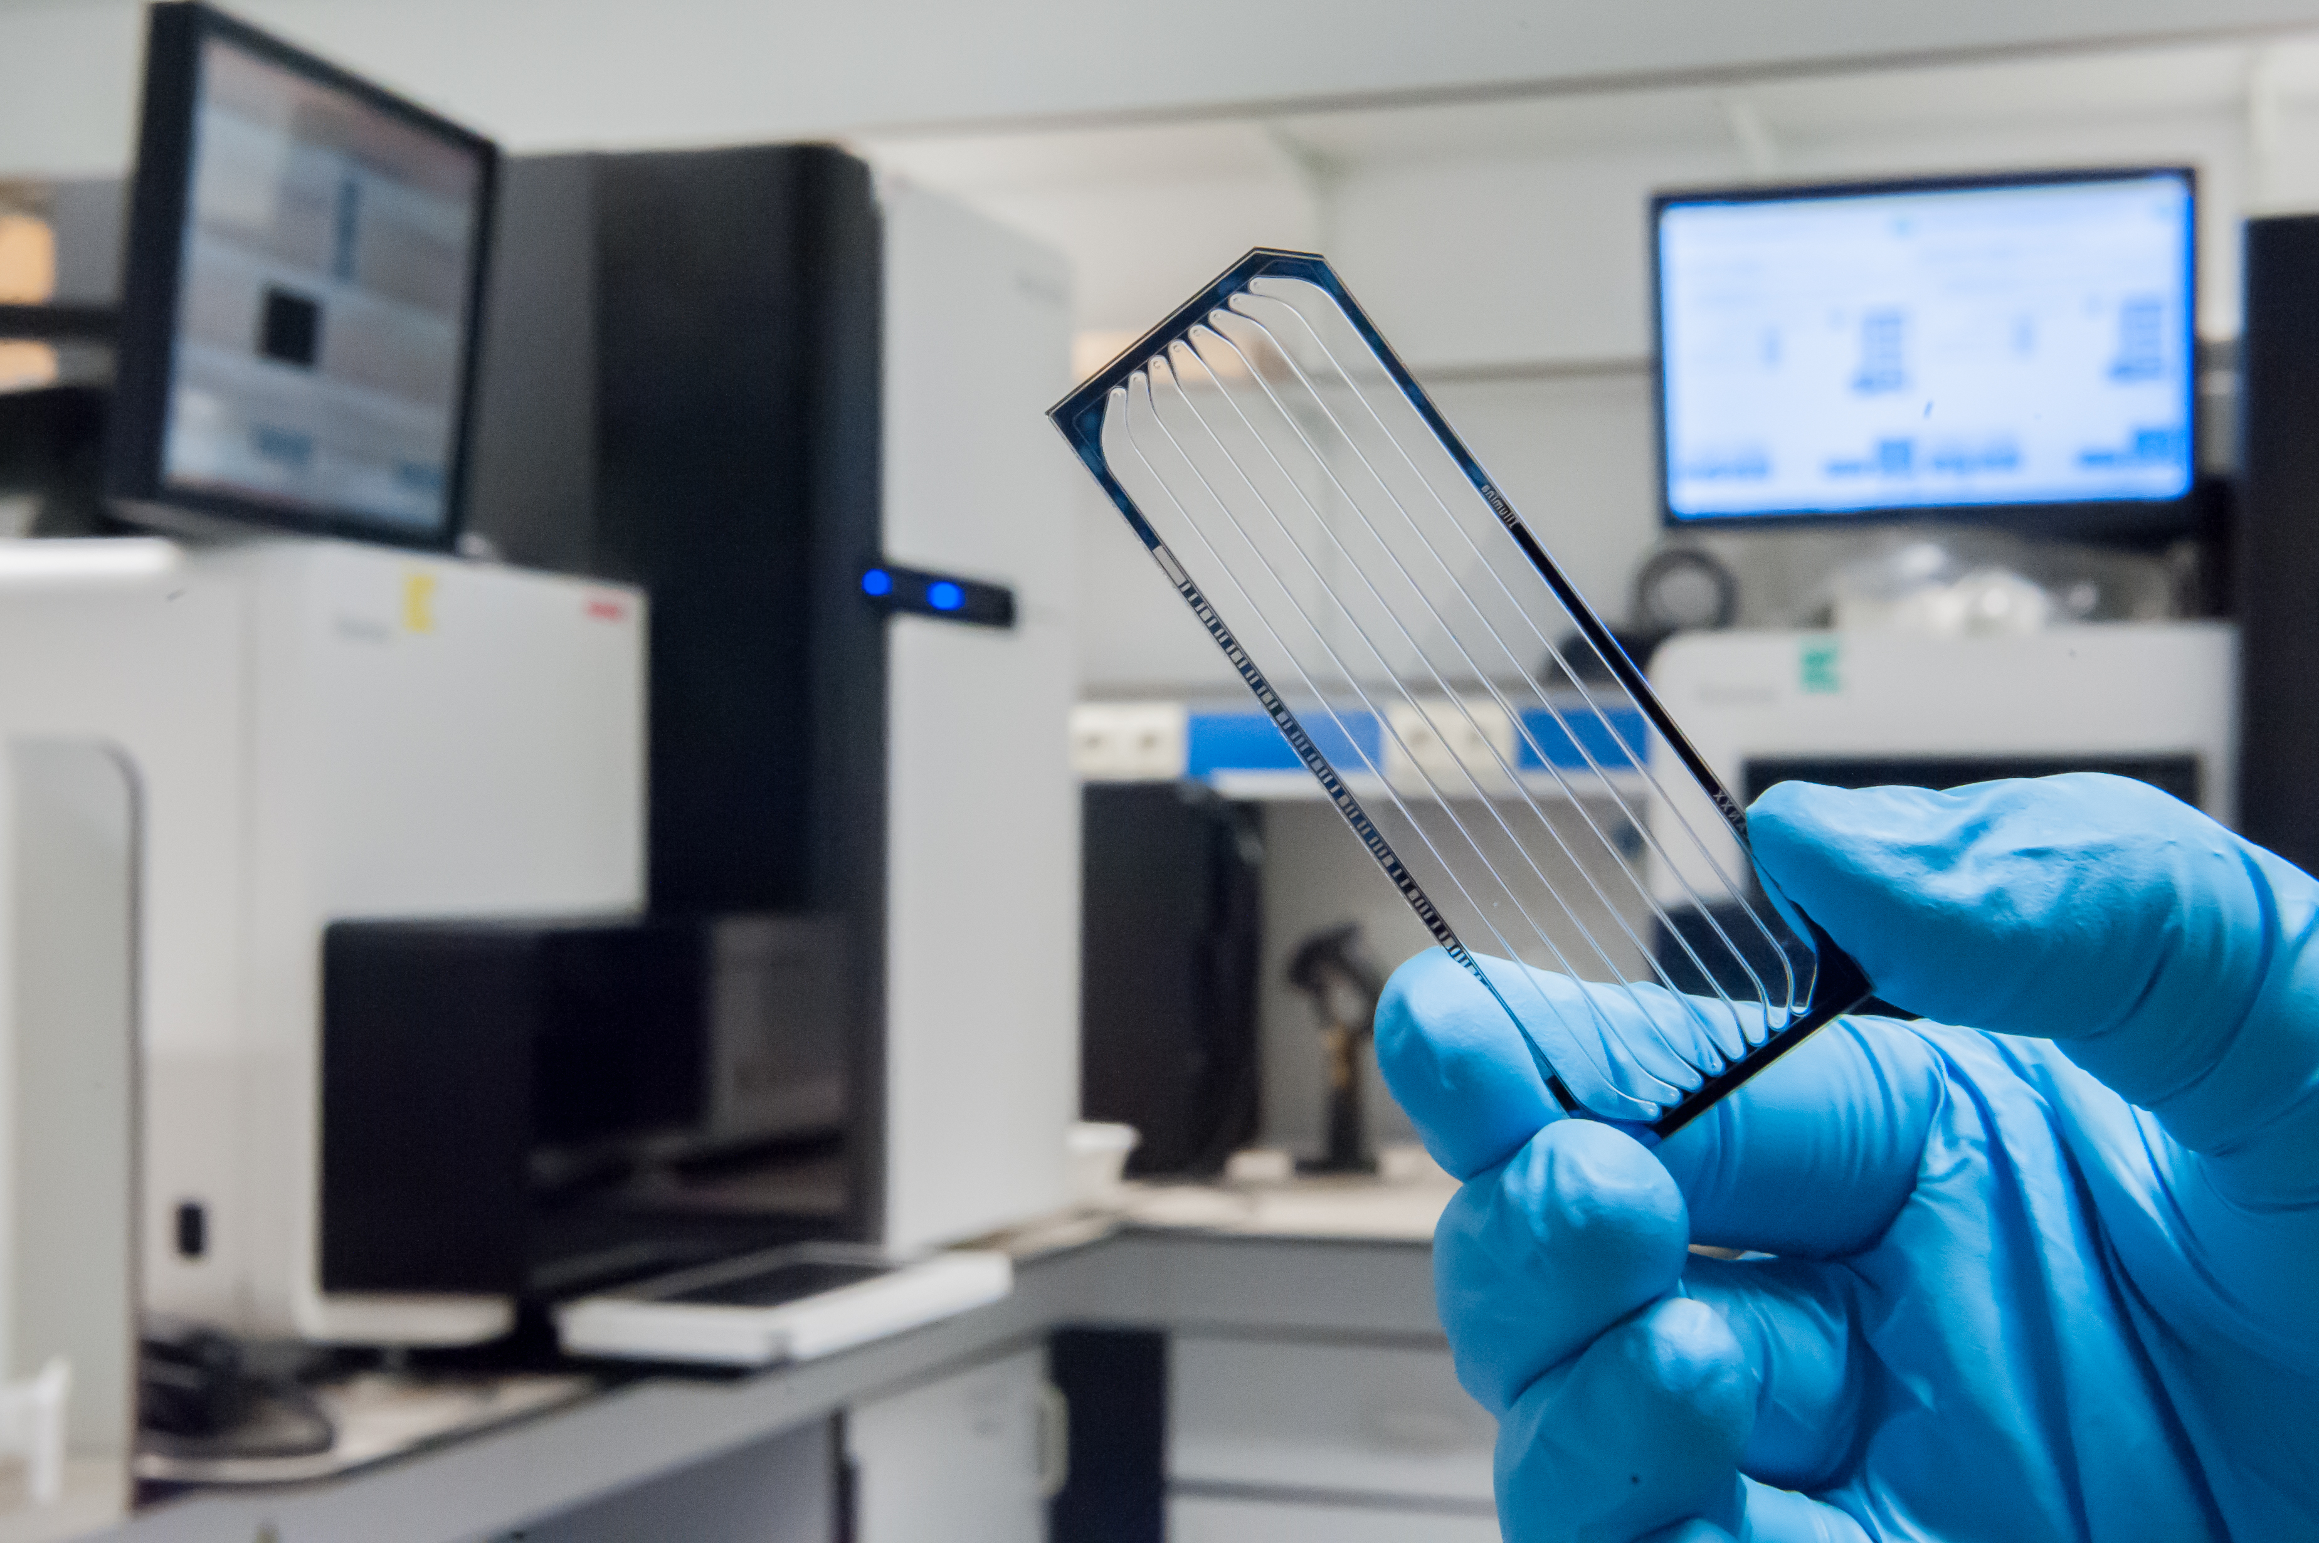

Other NGS applications:
CNV, structural variation, RNA-Seq
Erika Souche
Álvaro Cortés Calabuig

Slide 2
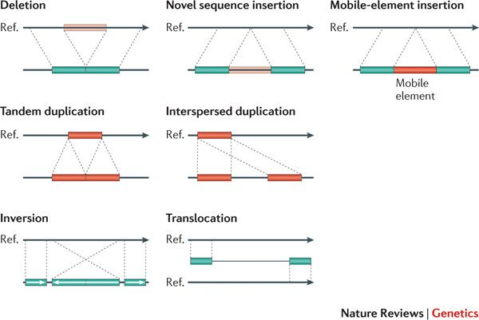
Definitions
Structural Variant (SV)
Copy Number Variant (CNV)
Deletion
Duplication
Triplication
…
Insertion
Inversion
Translocation
Alkan et al., 2011
Notes:
variation in structure of an organism’s chromosome

Slide 3
Detecting CNVs
Reference genome

Slide 4
Detecting CNVs
Based on Read Counts (RC)
Reference genome

Slide 5
Detecting CNVs
Based on Read Counts (RC)
Reference genome

Slide 6
Detecting CNVs
Based on Read Counts (RC)
Reference genome

Slide 7
Detecting CNVs
Based on Read Counts (RC)
Reference genome
17 start positions
10 start positions
11 start positions
Comparison to reference
18 start positions
21 start positions
15 start positions
No CNV
Deletion
No CNV ?

Slide 8
Detecting CNVs
Based on Read Counts (RC)
Reference genome
No CNV
Deletion
No CNV ?

Slide 9
Detecting CNVs
Based on Read Counts (RC)
Reference genome

Slide 10
Detecting CNVs
Based on Read Counts (RC)
Reference genome
Comparison to reference
No CNV
Deletion
No CNV

Slide 11
Detecting CNVs
Based on Read Counts (RC)
Reference genome
No CNV
Deletion
No CNV

Slide 12
Detecting CNVs
Based on Read Pairs (RP)
Reference genome
No CNV
Deletion
No CNV

Slide 13
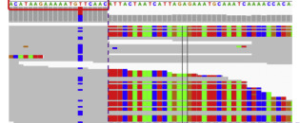
Detecting CNVs
Based on Split Reads (SR)
Reference genome

Slide 14
Detecting CNVs
Based on Split Reads (SR)
Reference genome
No CNV
Deletion
No CNV

Slide 15
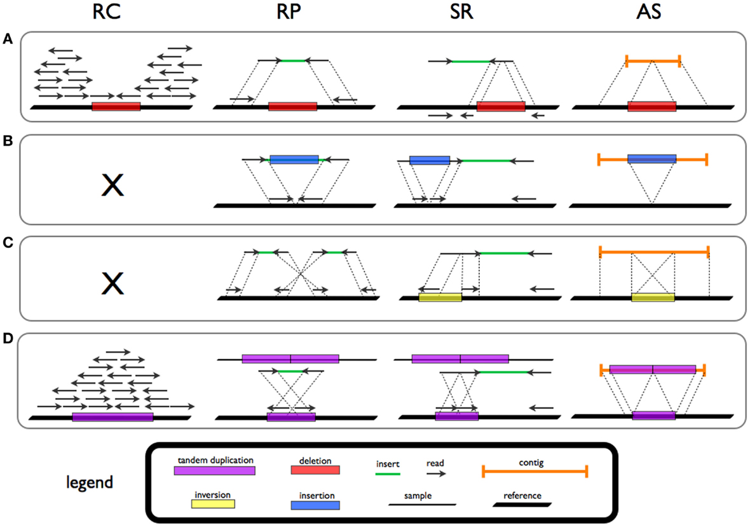
Detecting CNVs
Deletion supported by
Read counts
Read pairs

Slide 16
Detecting SVs
Deletion
Insertion
Inversion
Duplication
Tattini et al., Front. Bioeng. Biotechnol., 2015

Slide 17
Summary
SV detection possible by WGS
Resolution dependent on
Depth of coverage
Detection algorithm used
Limitations
SVs in segmental duplications, repetitive regions
Complex SVs
Notes:
Shallow WGS
Split reads

Slide 18
SVs in targeted sequencing?
Strategies
Read Counts
Read Pairs
Split Reads
Limitations
Bias introduced during capture/PCR
Resolution dependent on targeted regions
No information on breakpoints
Only if breakpoints are part of/close to targeted regions

Slide 19
SVs in targeted sequencing
Capture sequencing
Reference genome

Slide 20
SVs in targeted sequencing
Capture sequencing
Reference genome

Slide 21
SVs in targeted sequencing
Capture sequencing
Reference genome

Slide 22
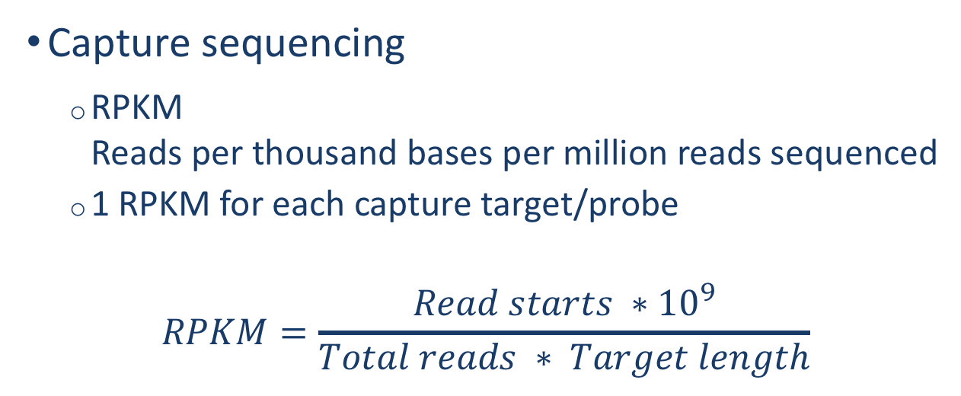
SVs in targeted sequencing
Capture sequencing
RPKM Reads per thousand bases per million reads sequenced
1 RPKM for each capture target/probe
$$RPKM=\frac{\left.Read starts ∗{10}^{9}\right.}{Total reads ∗ Target length}$$

Slide 23
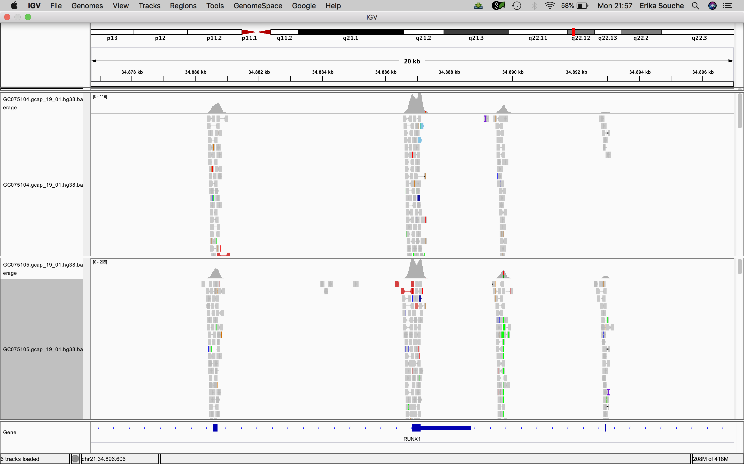
SVs in capture sequencing
0 - 119
0 - 265

Slide 24
SVs in capture sequencing
RPKM
=
42.32
RPKM = 26.25
RPKM
=
78.05
RPKM = 37.88

Slide 25
SVs in capture sequencing

Slide 26
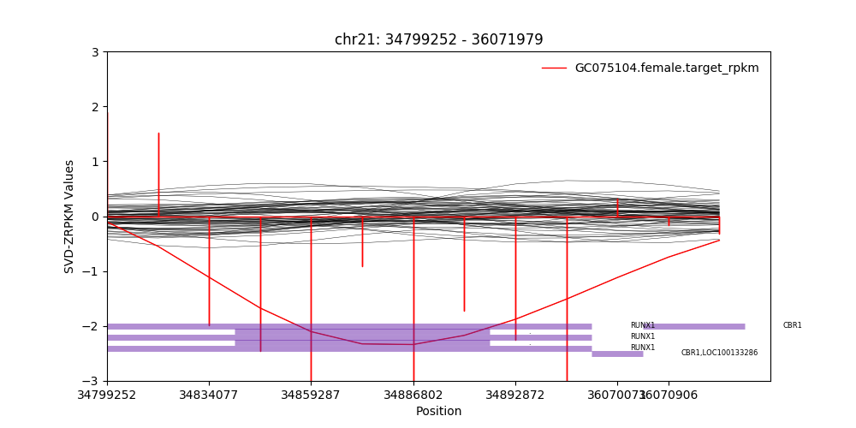
SVs in capture sequencing
Plot generated by CoNIFER
Krumm et al., Genome Research, 2012

Slide 27
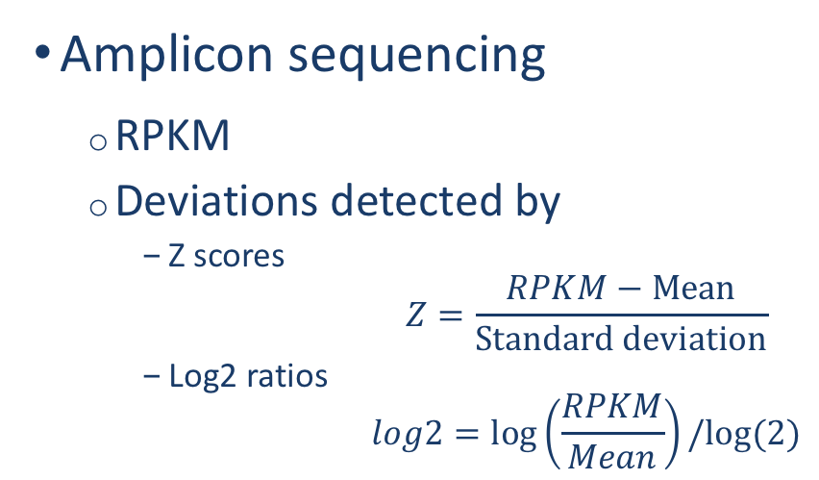
SVs in targeted sequencing
Amplicon sequencing
RPKM
Deviations detected by
Z scores $Z=\frac{RPKM−Mean}{Standard deviation}$
Log2 ratios $log2=\log\left(\frac{RPKM}{Mean}\right)/log⁡(2)$
 | Deletion | Duplication
Z score | < -3 | > 3
Log2 ratio | < -0.7 | > 0.5

Slide 28
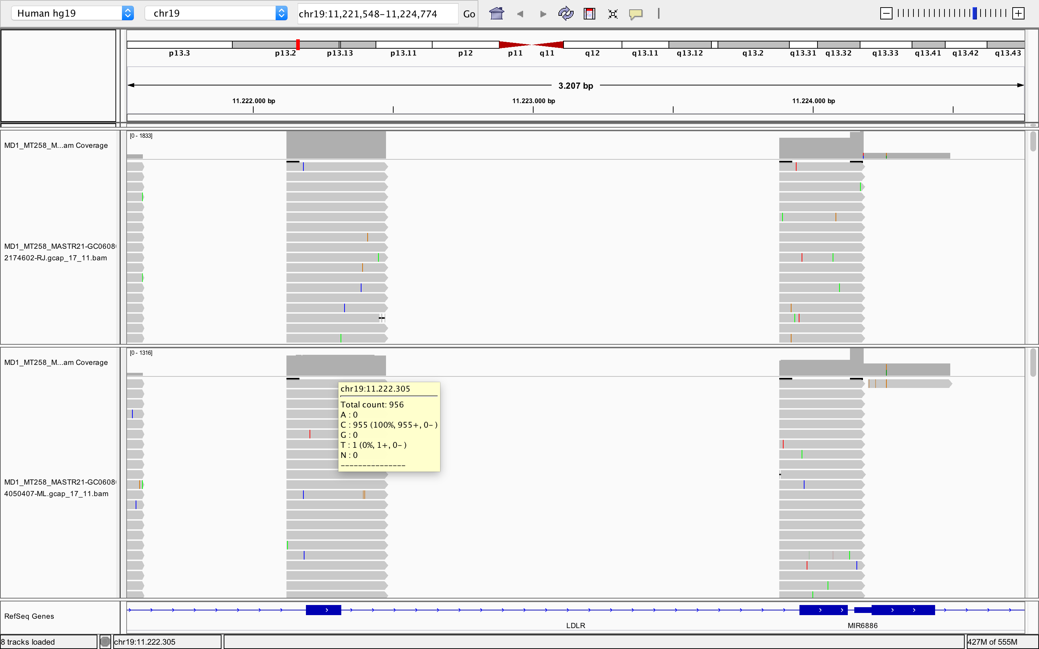
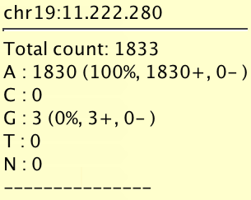
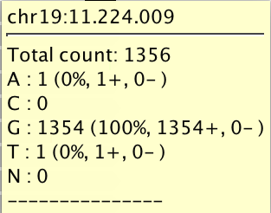
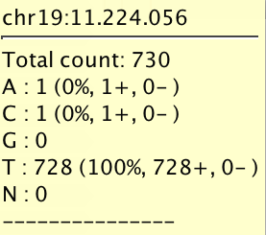
SVs in amplicon sequencing
1830
1356
956
730

Slide 29
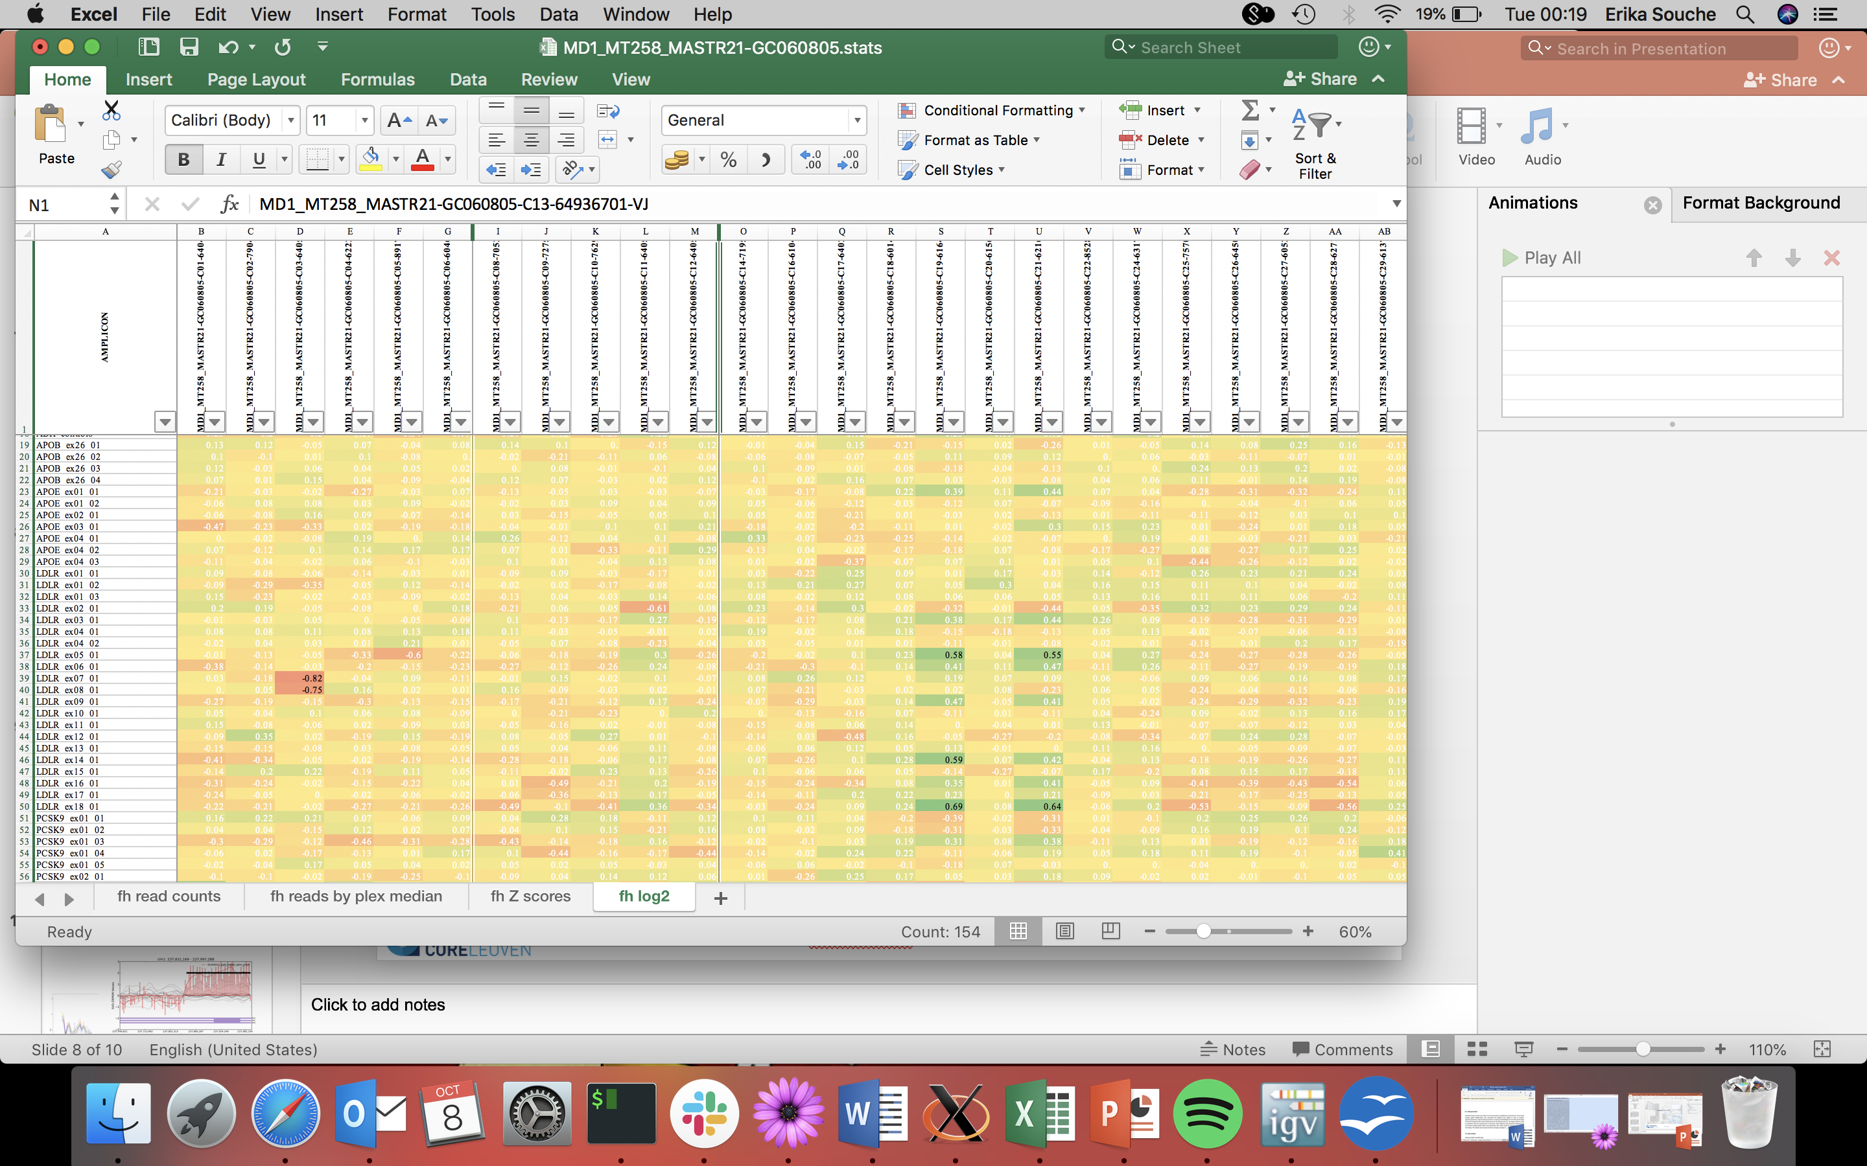
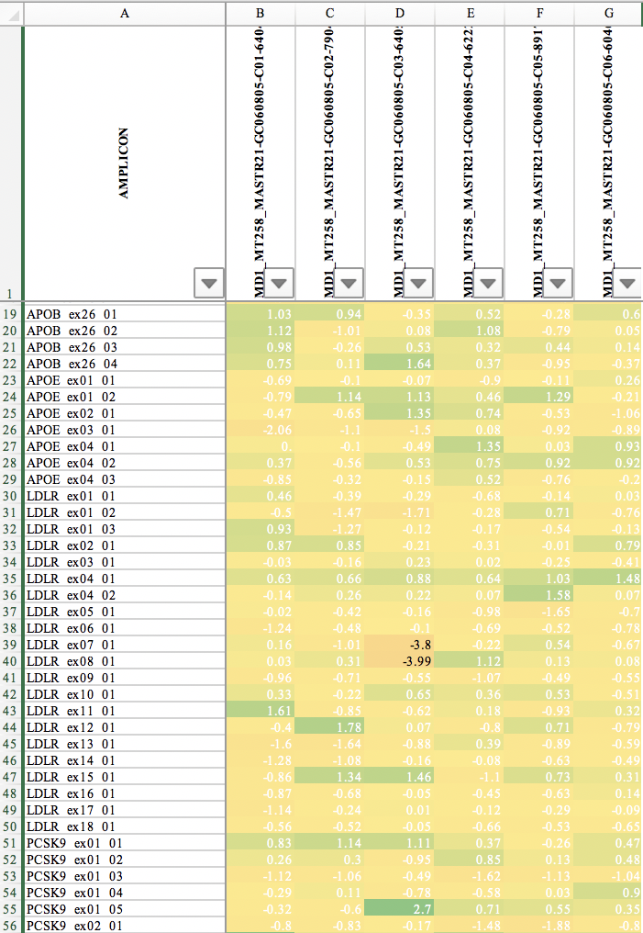
SVs in amplicon sequencing
Z score
Log2 ratio

Slide 30
Questions?
Erika Souche
Álvaro Cortés Calabuig

Slide 31
Copy Number Variants (CNVs)
Detection based on read counts
Reference genome
17 start positions
10 start positions
11 start positions
Comparison to reference
18 start positions
21 start positions
15 start positions
No CNV
Deletion
No CNV ?

